Slide 1


Stock Prices Forecasting

Slide 2


Meet the Team...
Richard Gachiri
Emmanuellar Karisa
Laura Mutheu
Daniel Muriithi
Alice Nyamongo
Chepkemoi Ruto

Slide 3


Outline
1
Business Understanding
4
Forecasting Tool
2
5
Objectives
Conclusion
3
Data and Methods
6
Recommendation

Slide 4
Overview
StockTech in Kenya is revolutionizing user engagement with state-of-the-art technology. By employing cutting-edge predictive modeling techniques, StockTech is poised to deliver highly customized stock market predictions, catering to the growing appetite for personalized investment insights in the Kenyan financial landscape.

Slide 5

Business Understanding
Today’s finance world needs timely access to real time stock market to make well informed decisions . Timely data empowers investors and traders to craft effective strategies and manage risks more effectively.There is increasing need to leverage the available rich data to identify emerging trends and forecast stock prices. This project seeks to bridge the gap between data and strategic decision making by providing finance stakeholders with robust tools to navigate the complexities of stock market.

Slide 6

Project Objectives
1).Top Objective: Develop a forecasting tool using real-time and historical stock market data
2).Bridge the gap between raw financial data and strategic decision-making
3).Empower stakeholders in the financial sector to navigate stock market complexities
4).Redefine the boundaries of predictive analytics in finance

Slide 7

Methodology
Data Cleaning
Analyzing data to explore trends and patterns
Extracting relevant features from the data
Testing and evaluating models to identify best performing one
Retuning the selected model to enhance perfomance
Deploying the model

Slide 8
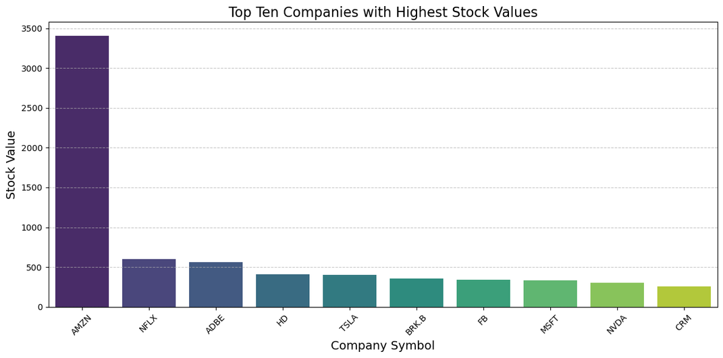
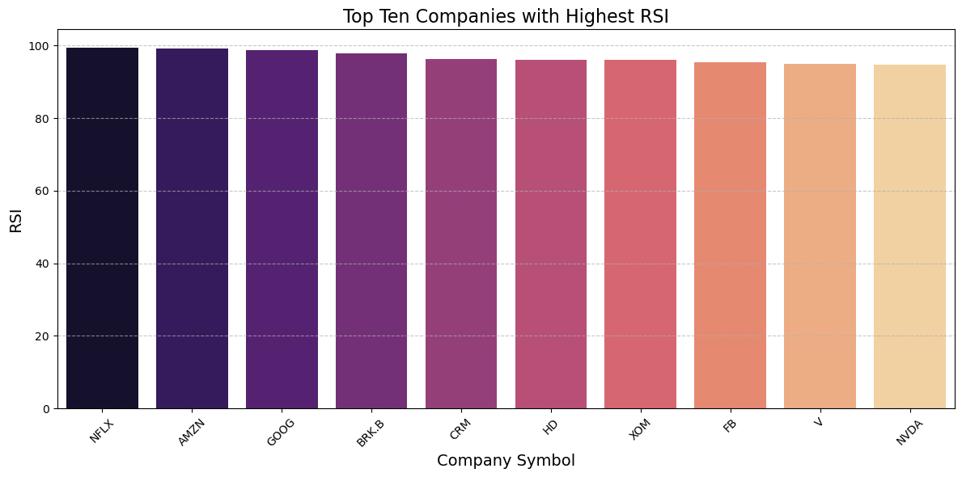
Data Exploration
2022 stock price data for 27 companies
Amazon maintained the highest stock price throughout 2022
Most company stock prices range below $500
8 of the companies with high RSI are among those with high stock prices.
These companies have high relative strength indices of over 90
The high indices suggest that the stock may be overbought

Slide 9
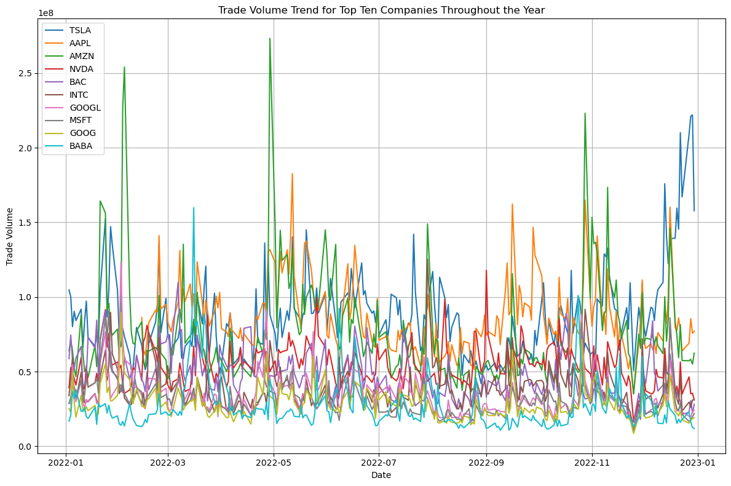
Data Exploration: Trade Volume Trend
Top traders:Tesla, Apple Inc, Amazon, NVIDIA Corporation, and Bank of America Coorporation
High trade volume indicates a high level of investor interest

Slide 10
Modeling
To determine which model is the best fit, we looked at the criteria of the Akaike information criterion (AIC) or the Bayesian Information Criterion (BIC).
Moving Averages - 3246.632 3254.410
Autoregressive Model - 3248.458 3260.124
Autoregressive Moving Averages -3250.417 3265.972
Autoregressive Integrated Moving Averages - 3242.061 3253.719
Seasonal AutoRegressive Moving Average Model - 3102.358 3105.831
When the SARIMA model is compared to the Prophet model The Prophet model captures the underlying patterns and dynamics of the stock market data more effectively than the SARIMA model. This is because of Prophet's ability to handle complex seasonal patterns and trend changes in the data more intuitively.
Therefore prophet model is performing better in terms of predictive accuracy for the given dataset and forecasting horizon thus the best model.
https://capstone-project-stock-prediction.streamlit.app/

Slide 11
Conclusion
Bridging financial data with strategic decision-making enables actionable insights for stakeholders.
Empowering financial stakeholders with predictive tools enhances stock market navigation.
Pioneering innovative methodologies in predictive analytics redefines finance, driving tangible value and sustainable growth.

Slide 12

Recommendations
Optimize Portfolio Management:
Monitor Market Drivers:
Continuous Learning and Adaptation:

Slide 13
...THANK YOU

